Slide 1
Estimating wolf occupancy with R Olivier Gimenez
Notes:
Today I’m gonna talk about SDM obviously, and a particular class of occupancy models that have been specifically designed to
account for the imperfect detection of species.
This is joint work with several colleagues, some of them from the French Game and Wildlife Agency and others from the CEFE, including two
very clever PhD students of mine : Julie and Laetitia.

Slide 2
Lecture 1 Introduction
Estimating wolf occupancy with R
Notes:
Today I’m gonna talk about SDM obviously, and a particular class of occupancy models that have been specifically designed to
account for the imperfect detection of species.
This is joint work with several colleagues, some of them from the French Game and Wildlife Agency and others from the CEFE, including two
very clever PhD students of mine : Julie and Laetitia.

Slide 3
Occupancy to map species distribution
Occupancy: proportion of an area occupied by a species
Species range dynamics
Habitat preferences
Metapopulation dynamics
…
0 | 0 | 1 | 0 | 0
0 | 1 | 0 | 0 | 0
0 | 1 | 1 | 0 | 0
0 | 0 | 1 | 0 | 0
1 | 0 | 1 | 0 | 0
0 | 1 | 0 | 0 | 0
0 | 0 | 0 | 0 | 1
0 | 0 | 0 | 0 | 1
10/40 = 0.25
Levins 1967, McKenzie et al. 2003, 2006
Notes:
I will use the notion of occupancy to do species distribution models.
Occupancy is usually defined as the proportion of an area occupied by a species, as in this example where a
fake species has been found on 10 sites out of 40 sites, hence an occupancy of 40%.
Occupancy is a key notion for addressing important questions in macroecology, biogeography and conservation biology like for example
the study of species range dynamics, the preferences of a species in terms of habitat or the study of metapopulation dynamics, among others.
You’ll see several examples of these topics today.

Slide 4
Issue of detectability < 1
0 | 0 | 1 | 0 | 0
0 | 1 | 0 | 0 | 0
0 | 1 | 1 | 0 | 0
0 | 0 | 1 | 0 | 0
1 | 0 | 1 | 0 | 0
0 | 1 | 0 | 0 | 0
0 | 0 | 0 | 0 | 1
0 | 0 | 0 | 0 | 1
True occupancy = 25%
Notes:
Occupancy is difficult to estimate in the field, due to the issue of detectability lower than one;
the species cannot be detected for various reasons even though it is present
Let’s take the same example as before, in which true occupancy was 40%

Slide 5
Issue of detectability < 1
0 | 0 | 1 | 0 | 0
0 | 1 | 0 | 0 | 0
0 | 1 | 1 | 0 | 0
0 | 0 | 1 | 0 | 0
1 | 0 | 1 | 0 | 0
0 | 1 | 0 | 0 | 0
0 | 0 | 0 | 0 | 1
0 | 0 | 0 | 0 | 1
0 | 0 | 1 | 0 | 0
0 | 1 | 0 | 0 | 0
0 | 1 | 1 | 0 | 0
0 | 0 | 1 | 0 | 0
1 | 0 | 1 | 0 | 0
0 | 1 | 0 | 0 | 0
0 | 0 | 0 | 0 | 1
0 | 0 | 0 | 0 | 1
Species detected in 6 occupied sites
True occupancy = 25%
Notes:
Now if for some reasons, you manage to detect the species in only 6 sites out of the
10 sites that are actually occupied,

Slide 6
Occupancy underestimation
0 | 0 | 1 | 0 | 0
0 | 1 | 0 | 0 | 0
0 | 1 | 1 | 0 | 0
0 | 0 | 1 | 0 | 0
1 | 0 | 1 | 0 | 0
0 | 1 | 0 | 0 | 0
0 | 0 | 0 | 0 | 1
0 | 0 | 0 | 0 | 1
0 | 0 | 1 | 0 | 0
0 | 1 | 0 | 0 | 0
0 | 1 | 1 | 0 | 0
0 | 0 | 1 | 0 | 0
1 | 0 | 1 | 0 | 0
0 | 1 | 0 | 0 | 0
0 | 0 | 0 | 0 | 1
0 | 0 | 0 | 0 | 1
Species detected in 6 occupied sites
Naive occupancy estimate = 6/40 = 15%
True occupancy = 25%
Notes:
Then you obtain a naive estimate for occupancy of 15%
In other words, occupancy is underestimated if imperfect detection is not accounted for.

Slide 7
Issue of detectability < 1
Pr
detectability
true occupancy
time
Notes:
Another issue occurs when you’re interested in trends in occupancy.
In this example, true occupancy is decreasing, while detectability is increasing.

Slide 8
Bias in occupancy trends
Pr
detectability
true occupancy
observed occupancy
time
Notes:
Then, the two process play against each other so that we obtain a flat observed occupancy
In other words, you’ve missed the trends in occupancy if you don’t account for imperfect detection and variation in it.

Slide 9
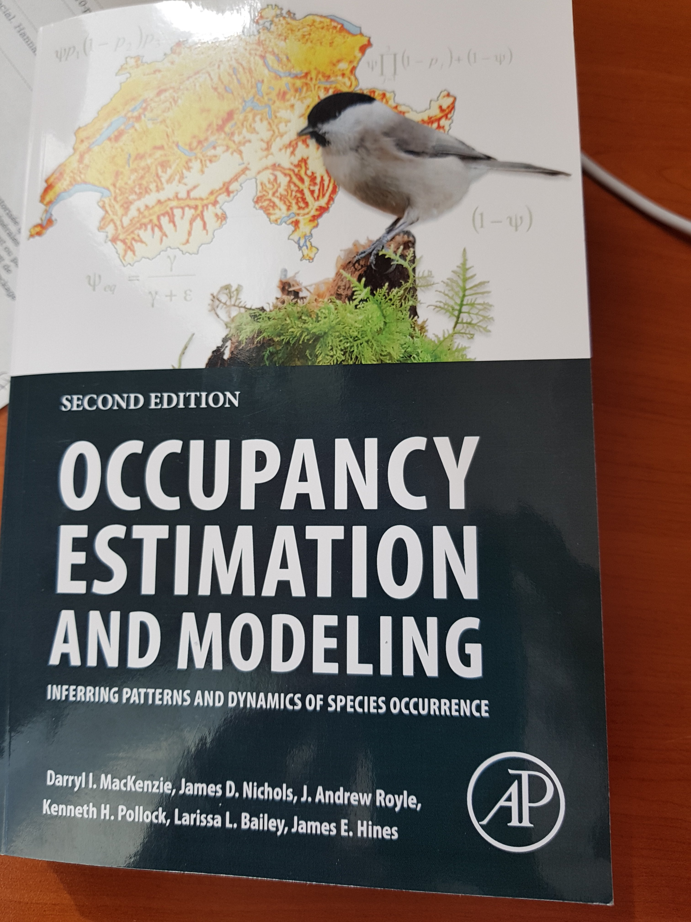

Occupancy models
Notes:
There is a bunch of papers on occupancy models.
Here is a recent example of the use of occupancy models to model species distribution by José, Guru and Brendan.
I also recommend the recent review by Larissa, Darryl and Jim published in MEE.

Slide 10
Occupancy protocol
Several sampling units surveyed
Notes:
So, how do occupancy protocols work? Well you define your study area, then consider several
sampling units to be surveyed, the rectangles here.

Slide 11
Occupancy protocol
1
0
Several sampling units surveyed
Collection of detection/non-detection
0
1
1
0
Notes:
Then you go on the field to collect detection/non-detection data.

Slide 12
Occupancy protocol
1001
0011
Several sampling units surveyed
Collection of detection/non-detection
Replicate surveys in each unit
0000
1011
1111
0000
Notes:
The key is to replicate those surveys in each unit to be able to estimate detection.

Slide 13
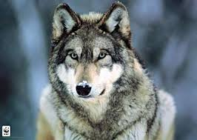
True or false absence?
1001
0011
0000
1011
1111
reality
Notes:
On an example, let’s assume that wolves are distributed this way. With a rectangle here where the species
Is absent, the site is unoccupied, and all the other sites are occupied.

Slide 14
True or false absence?
1001
0011
1001
0011
0000
0000
1011
1011
1111
1111
0000
reality
observation
Notes:
You go on the field, then you get 1’s and 0’s for each of these sites.
For most of these sites, there is at least a detection, but for two sites, we have
exclusively non-detections.

Slide 15
True or false absence?
1001
0011
1001
0011
0000
0000
1011
1011
1111
1111
0000
reality
observation
Notes:
We can then confirm the presence of the species of all sites but the two where we have 0’s only.

Slide 16
True or false absence?
1001
0011
1001
0011
0000
?
1011
1011
1111
1111
?
reality
observation
Notes:
Is the species present at these two sites or not?

Slide 17
Data structure
Sampling units = sites
We do repeated observations at each site
 | visit 1 | visit 2 | visit 3
site 1 | 1 | 0 | 1
site 2 | 0 | 1 | 1
… | … | … | …
site 3 | 0 | 0 | 0

Slide 18
Lecture 2 Static aka single-season occupancy models
Estimating wolf occupancy with R
Notes:
Today I’m gonna talk about SDM obviously, and a particular class of occupancy models that have been specifically designed to
account for the imperfect detection of species.
This is joint work with several colleagues, some of them from the French Game and Wildlife Agency and others from the CEFE, including two
very clever PhD students of mine : Julie and Laetitia.

Slide 19
Single-season occupancy model likelihood
ψ₁ = prob. a site is initially occupied - occupancy
p = prob. species is detected (given presence) – detection
Notes:
More precisely, the initial states and the observation process are the same as in the dynamic model.
It’s only the state process that is now driven by the identity matrix, meaning that you stay in the state you are initially in.

Slide 20
Single-season occupancy model likelihood
ψ₁ = prob. a site is initially occupied - occupancy
p = prob. species is detected (given presence) – detection
Assuming closure, and independence of surveys:
Pr(1001) = ?
Notes:
Species was present on this specific site, and detected twice, missed twice

Slide 21
Single-season occupancy model likelihood
ψ₁ = prob. a site is initially occupied - occupancy
p = prob. species is detected (given presence) – detection
Assuming closure, and independence of surveys:
Pr(1001) = ψ₁ p (1 – p) (1 – p) p
Notes:
Species was present on this specific site, and detected twice, missed twice

Slide 22
Single-season occupancy model likelihood
ψ₁ = prob. a site is initially occupied - occupancy
p = prob. species is detected (given presence) – detection
Assuming closure, and independence of surveys:
Pr(0000) = ?
Notes:
Species was present on this specific site, and missed twice at every survey; or the species was absent.

Slide 23
Single-season occupancy model likelihood
ψ₁ = prob. a site is initially occupied - occupancy
p = prob. species is detected (given presence) – detection
Assuming closure, and independence of surveys:
Pr(0000) = ψ₁ (1 – p) (1 – p) (1 – p) (1 – p) + (1 - ψ₁)
Notes:
Species was present on this specific site, and missed twice at every survey; or the species was absent.

Slide 24
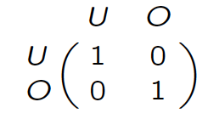
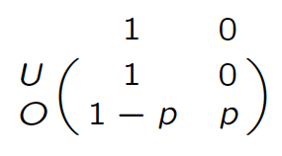
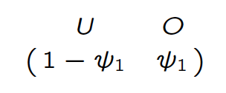
Single-season occupancy model
Initial states
Observation process
State process
Markov model
hidden
O = occupied; U = unoccupied
ψ₁ = occupancy, p = detection
Notes:
More precisely, the initial states and the observation process are the same as in the dynamic model.
It’s only the state process that is now driven by the identity matrix, meaning that you stay in the state you are initially in.

Slide 25
Single-season occupancy model
Initial states
Observation process
State process
t+1
t
Markov model
hidden
O = occupied; U = unoccupied
ψ₁ = occupancy, p = detection
Notes:
More precisely, the initial states and the observation process are the same as in the dynamic model.
It’s only the state process that is now driven by the identity matrix, meaning that you stay in the state you are initially in.

Slide 26
Single-season occupancy model
Initial states
Observation process
State process
t+1
t
t
t
Markov model
hidden
O = occupied; U = unoccupied
ψ₁ = occupancy, p = detection
Notes:
More precisely, the initial states and the observation process are the same as in the dynamic model.
It’s only the state process that is now driven by the identity matrix, meaning that you stay in the state you are initially in.

Slide 27
Data structure
We do repeated observations at each site
 | visit 1 | visit 2 | visit 3
site 1 | 1 | 0 | 1
site 2 | 0 | 1 | 1
… | … | … | …
site 10 | 0 | 0 | 0

Slide 28
Covariates

Slide 29
Covariates
Site-level covariates (e.g. % forest cover)
 | visit 1 | visit 2 | visit 3 |  | habitat
site 1 | 1 | 0 | 1 |  | good
site 2 | 0 | 1 | 1 |  | bad
… | … | … | … |  | …
site 10 | 0 | 0 | 0 |  | bad

Slide 30
Covariates
Observation-level covariates (e.g. temperature)
 | visit 1 | visit 2 | visit 3 |  | date1 | date2 | date3
site 1 | 1 | 0 | 1 |  | 2 | 5 | 0
site 2 | 0 | 1 | 1 |  | -4 | 8 | 2
… | … | … | … |  | …
site 10 | 0 | 0 | 0 |  | -1 | 2 | -3

Slide 31

Covariates
Allow occupancy and detection to be a function of covariates
When dealing with probabilities between 0 and 1, we need a link function (as in GLMs) to force estimates to remain in range
We usually use the logit function $logit\left(θ\right)=log⁡\left(\frac{θ}{1−θ}\right)$

Slide 32
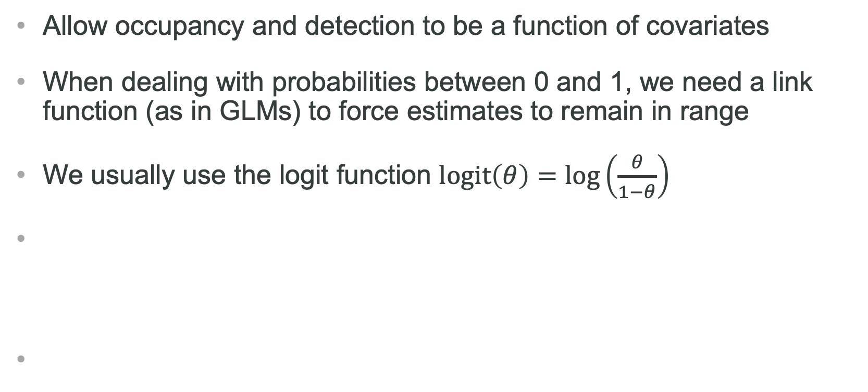
Covariates
Allow occupancy and detection to be a function of covariates
When dealing with probabilities between 0 and 1, we need a link function (as in GLMs) to force estimates to remain in range
We usually use the logit function $logit\left(θ\right)=log⁡\left(\frac{θ}{1−θ}\right)$
E.g. for a site-level covariate % forest cover measured at site i :
$$logit\left(ψ_{i}\right)=a+b{ forest}_{i}$$
Where paramaters a and b are intercept and slope to be estimated

Slide 33
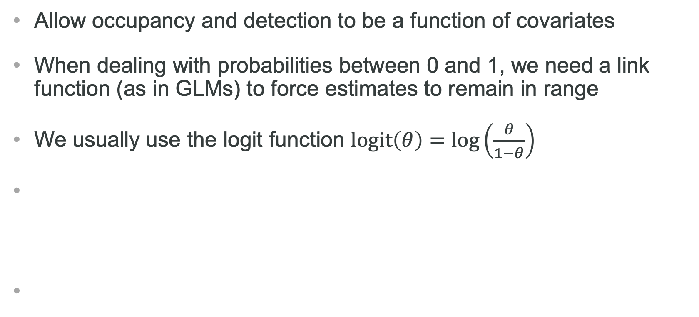
Covariates
Allow occupancy and detection to be a function of covariates
When dealing with probabilities between 0 and 1, we need a link function (as in GLMs) to force estimates to remain in range
We usually use the logit function $logit\left(θ\right)=log⁡\left(\frac{θ}{1−θ}\right)$
E.g. for an observation-level covariate temperature at site i in visit j :
$$logit\left(p_{ij}\right)=a+b{ temperature}_{ij}$$
Where paramaters a and b are intercept and slope to be estimated

Slide 34
Key occupancy model assumptions
Sites are closed (occupation does not change)
Independent detections
No unmodelled heterogeneity
No false positives
Notes:
As any statistical model, they rely on assumptions that need to be fullfilled for safe inference.

Slide 35
Key occupancy model assumptions
1. Sites are not closed (occupation does change)
- Occupancy should be interpreted as ‘use’.
- Relax assumption, see Lecture 3.
Independent detections
No unmodelled heterogeneity
No false positives
Notes:
As any statistical model, they rely on assumptions that need to be fullfilled for safe inference.

Slide 36
Key occupancy model assumptions
2. Dependent detections
- Species easier/more difficult to detect at a site where it has already been detected, or sampling close in time.
- Adapt sampling design; account for dependence in model.
Independent detections
No unmodelled heterogeneity
No false positives
Notes:
As any statistical model, they rely on assumptions that need to be fullfilled for safe inference.

Slide 37
Key occupancy model assumptions
3. Heterogeneity in detection
- Occupancy is lower than it should be.
- Account for heterogeneity in model (random effects [package ubms], finite mixtures, Royle-Nichols model if heterogeneity due to variation in abundance [function occuRN() in unmarked]).
Independent detections
No unmodelled heterogeneity
No false positives
Notes:
As any statistical model, they rely on assumptions that need to be fullfilled for safe inference.

Slide 38
Key occupancy model assumptions
4. False positives
- See Lecture 4.
Independent detections
No unmodelled heterogeneity
No false positives
Notes:
As any statistical model, they rely on assumptions that need to be fullfilled for safe inference.

Slide 39
Live demo
Estimating wolf occupancy with R
Notes:
Today I’m gonna talk about SDM obviously, and a particular class of occupancy models that have been specifically designed to
account for the imperfect detection of species.
This is joint work with several colleagues, some of them from the French Game and Wildlife Agency and others from the CEFE, including two
very clever PhD students of mine : Julie and Laetitia.

Slide 40


Slide 41
Lecture 3 Dynamic aka multiple-season occupancy models
Estimating wolf occupancy with R
Notes:
Today I’m gonna talk about SDM obviously, and a particular class of occupancy models that have been specifically designed to
account for the imperfect detection of species.
This is joint work with several colleagues, some of them from the French Game and Wildlife Agency and others from the CEFE, including two
very clever PhD students of mine : Julie and Laetitia.

Slide 42
Single-season model assumptions
Sites are closed (occupation does not change)
Independent detections
No unmodelled heterogeneity
No false positives
Notes:
As any statistical model, they rely on assumptions that need to be fullfilled for safe inference.

Slide 43
Single-season model assumptions
Sites are not closed (occupation does change)
Independent detections
No unmodelled heterogeneity
No false positives
Notes:
As any statistical model, they rely on assumptions that need to be fullfilled for safe inference.

Slide 44
Data structure
We do repeated observations at each site
 | season 1
 | visit 1 | visit 2 | visit 3
site 1 | 1 | 0 | 1
site 2 | 0 | 1 | 1
… | … | … | …
site 10 | 0 | 0 | 0

Slide 45
Data structure
We do repeated observations at each site within season (or year)
 | season 1
 | visit 1 | visit 2 | visit 3
site 1 | 1 | 0 | 1
site 2 | 0 | 1 | 1
… | … | … | …
site 10 | 0 | 0 | 0
season 2
visit 1 | visit 2 | visit 3
0 | 0 | 1
0 | 1 | 1
… | … | …
0 | 1 | 0

Slide 46
Data structure
We do repeated observations at each site within season (or year)
 | season 1
 | visit 1 | visit 2 | visit 3
site 1 | 1 | 0 | 1
site 2 | 0 | 1 | 1
… | … | … | …
site 10 | 0 | 0 | 0
season 2
visit 1 | visit 2 | visit 3
0 | 0 | 1
0 | 1 | 1
… | … | …
0 | 1 | 0
season 3
visit 1 | visit 2 | visit 3
1 | 1 | 1
0 | 1 | 1
… | … | …
1 | 0 | 0

Slide 47
Data structure
A sequence of single-season studies conducted over several seasons (or years) at same sites
 | season 1
 | visit 1 | visit 2 | visit 3
site 1 | 1 | 0 | 1
site 2 | 0 | 1 | 1
… | … | … | …
site 10 | 0 | 0 | 0
season 2
visit 1 | visit 2 | visit 3
0 | 0 | 1
0 | 1 | 1
… | … | …
0 | 1 | 0
season 3
visit 1 | visit 2 | visit 3
1 | 1 | 1
0 | 1 | 1
… | … | …
1 | 0 | 0

Slide 48
Data structure
Sites are closed within season, but occupancy may change across seasons due to colonisation/extinction events
 | season 1
 | visit 1 | visit 2 | visit 3
site 1 | 1 | 0 | 1
site 2 | 0 | 1 | 1
… | … | … | …
site 10 | 0 | 0 | 0
season 2
visit 1 | visit 2 | visit 3
0 | 0 | 1
0 | 1 | 1
… | … | …
0 | 1 | 0
season 3
visit 1 | visit 2 | visit 3
1 | 1 | 1
0 | 1 | 1
… | … | …
1 | 0 | 0

Slide 49
Dynamic of the states
season 1
occupied
unoccupied

Slide 50
Dynamic of the states
season 1
season 2
no extinction
occupied
extinction

Slide 51
Dynamic of the states
season 1
season 2
colonization
unoccupied
no colonization

Slide 52
Dynamic of the states
season 1
season 2
no extinction
occupied
ext.
col.
unoccupied
no colonization

Slide 53
Dynamic of the states
season 1
season 2
season 3
no extinction
no extinction
occupied
ext.
ext.
col.
col.
unoccupied
no colonization
no colonization
slide from D. MacKenzie

Slide 54
Dynamic (multi-season) occupancy models
extinction
O
U
ε
O = occupied; U = unoccupied
Notes:
This is what occupancy models have been designed for.
How does a occupancy model work? Let’s focus on a dynamic occupancy model and let’s assume that we have perfect detection.
We consider a site between t and t + 1.
for example, you can go from an occupied site to an unoccupied site - this is the extinction process driven by the extinction prob epsilon.

Slide 55
Dynamic (multi-season) occupancy models
1 = species detected; 0 = species undetected
1
0
1
p
1-p
p
extinction
O
U
ε
O = occupied; U = unoccupied
Notes:
Now we relax the assumption of perfect detection and we assume that we do three visits.
Then the species goes detected or non-detected with probability p or 1-p.

Slide 56
Dynamic (multi-season) occupancy models
1 = species detected; 0 = species undetected
1
0
1
0
0
0
p
1-p
p
1
1
1
extinction
O
U
ε
O = occupied; U = unoccupied
Notes:
Of course, if the site is in state unoccupied, then the species goes undetected at all visits for sure.

Slide 57
Dynamic (multi-season) occupancy models
1 = species detected; 0 = species undetected
0
0
0
1
1
0
1
1
1
p
p
1-p
colonization
U
O
γ
O = occupied; U = unoccupied
Notes:
Now if the site is first unoccupied then occupied, we have the colonization process driven by the colonization prob gamma.

Slide 58
Dynamic (multi-season) occupancy models
ψ₁ = prob. a site is occupied - occupancy
p = prob. species is detected (given presence) – detection
γ = prob. unoccupied site becomes occupied – colonisation
ε = prob. occupied site becomes unoccupied – extinction

Slide 59
Dynamic occupancy model likelihood
ψ₁ = occupancy
p = detection
γ = colonisation
ε = extinction
Pr(110 000) = ?
Notes:
– Site occupied in season 1, and species detected in surveys 1 and 2, and
missed in survey 3.
– Between seasons 1 and 2 the site continued occupied and the species
was not detected in any of the three surveys OR the species became
locally extinct

Slide 60
Dynamic occupancy model likelihood
ψ₁ = occupancy
p = detection
γ = colonisation
ε = extinction
Pr(110 000) =
Three replicated surveys or secondary occasions
Closure assumption
Notes:
– Site occupied in season 1, and species detected in surveys 1 and 2, and
missed in survey 3.
– Between seasons 1 and 2 the site continued occupied and the species
was not detected in any of the three surveys OR the species became
locally extinct

Slide 61
Dynamic occupancy model likelihood
ψ₁ = occupancy
p = detection
γ = colonisation
ε = extinction
Pr(110 000) = ψ₁ p p (1 – p)
Three replicated surveys or secondary occasions
Closure assumption
Notes:
– Site occupied in season 1, and species detected in surveys 1 and 2, and
missed in survey 3.
– Between seasons 1 and 2 the site continued occupied and the species
was not detected in any of the three surveys OR the species became
locally extinct

Slide 62
Dynamic occupancy model likelihood
ψ₁ = occupancy
p = detection
γ = colonisation
ε = extinction
Pr(110 000) = ψ₁ p p (1 – p) [ ε + (1 – ε) … ]
Notes:
– Site occupied in season 1, and species detected in surveys 1 and 2, and
missed in survey 3.
– Between seasons 1 and 2 the site continued occupied and the species
was not detected in any of the three surveys OR the species became
locally extinct

Slide 63
Dynamic occupancy model likelihood
ψ₁ = occupancy
p = detection
γ = colonisation
ε = extinction
Pr(110 000) = ψ₁ p p (1 – p) [ ε + (1 – ε) (1 – p) (1 – p) (1 – p) ]
Notes:
– Site occupied in season 1, and species detected in surveys 1 and 2, and
missed in survey 3.
– Between seasons 1 and 2 the site continued occupied and the species
was not detected in any of the three surveys OR the species became
locally extinct

Slide 64
Dynamic occupancy model likelihood
ψ₁ = occupancy
p = detection
γ = colonisation
ε = extinction
Pr(000 010) = ?
Notes:
– Site occupied in season 1, and species detected in surveys 1 and 2, and
missed in survey 3.
– Between seasons 1 and 2 the site continued occupied and the species
was not detected in any of the three surveys OR the species became
locally extinct

Slide 65
Dynamic occupancy model likelihood
ψ₁ = occupancy
p = detection
γ = colonisation
ε = extinction
Pr(000 010) = [ ψ₁ (1 – p) (1 – p) (1 – p) (1 – ε) + (1 – ψ₁) γ ]
Notes:
– Site occupied in season 1, and species detected in surveys 1 and 2, and
missed in survey 3.
– Between seasons 1 and 2 the site continued occupied and the species
was not detected in any of the three surveys OR the species became
locally extinct

Slide 66
Dynamic occupancy model likelihood
ψ₁ = occupancy
p = detection
γ = colonisation
ε = extinction
Pr(000 010) = [ ψ₁ (1 – p) (1 – p) (1 – p) (1 – ε) + (1 – ψ₁) γ ]
x (1 – p) p (1 – p)
Notes:
– Site occupied in season 1, and species detected in surveys 1 and 2, and
missed in survey 3.
– Between seasons 1 and 2 the site continued occupied and the species
was not detected in any of the three surveys OR the species became
locally extinct

Slide 67
Derived parameters
ψ₁ = occupancy
p = detection
γ = colonisation
ε = extinction
Season-specific occupancy:
ψ_{t+1} = ψ_{t} (1 – ε_{t}) + (1 – ψ_{t}) γ_{t}
Rate of change in occupancy:
λ_{t} = ψ_{t+1} / ψ_{t}
Notes:
– Site occupied in season 1, and species detected in surveys 1 and 2, and
missed in survey 3.
– Between seasons 1 and 2 the site continued occupied and the species
was not detected in any of the three surveys OR the species became
locally extinct

Slide 68
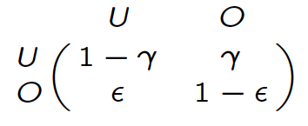
Dynamic occupancy model
Initial states
Observation process
State process
Markov model
hidden
Notes:
In a more formal waywe will use a hidden markov formulation of occupancy models for which you need is 3 ingredients;
1. The initial states, here you’re either unoccupied or occupied.
2. Then you have a Markov chain for the dynamic of the states from time t in row to t+1 in columns. This Markov chain is driven by the extinction and colonization probs.
For example, the prob of being occupied at t+1 given that you were unoccupied at t is gamma the colonization prob.
3. Finally, you add an extra layer to specify the link between the observations, non-detected or detected and the states, unoccupied or occupied.
For example, if the site is occupied, then the species is detected with prob p.

Slide 69
Single-season is a particular case of multi-season
No colonization (γ = 0) and no extinction (ε = 0)
Initial states
Observation process
State process
Notes:
From there, it’s quite easy to derive a formulation for the simpler single season occupancy models.
You just need to impose no extinction and no colonisation in the state process.

Slide 70
Live demo
Estimating wolf occupancy with R
Notes:
Today I’m gonna talk about SDM obviously, and a particular class of occupancy models that have been specifically designed to
account for the imperfect detection of species.
This is joint work with several colleagues, some of them from the French Game and Wildlife Agency and others from the CEFE, including two
very clever PhD students of mine : Julie and Laetitia.

Slide 72
Lecture 4 Occupancy models with species misidentification
Estimating wolf occupancy with R
Notes:
Today I’m gonna talk about SDM obviously, and a particular class of occupancy models that have been specifically designed to
account for the imperfect detection of species.
This is joint work with several colleagues, some of them from the French Game and Wildlife Agency and others from the CEFE, including two
very clever PhD students of mine : Julie and Laetitia.

Slide 73

Species misidentification
2013
How to account for false positives due to species misidentification?

Slide 74
Data
Observations by hunters (phone interviews); uncertainty in species identification
Telemetry;
no doubt about species
Habitat quality
Notes:
Uncertainty due to inexperience of some hunters, sensitivity of hunters to controversies about wolf management

Slide 75
Reminder: static occupancy model
Initial states
Observation process
State process
Notes:
More precisely, the initial states and the observation process are the same as in the dynamic model.
It’s only the state process that is now driven by the identity matrix, meaning that you stay in the state you are initially in.

Slide 76
Model allowing for false positives
Observation process
0
1
2
Uncertain detection
Detection with no doubt about the species
Notes:
More precisely, the initial states and the observation process are the same as in the dynamic model.
It’s only the state process that is now driven by the identity matrix, meaning that you stay in the state you are initially in.

Slide 77
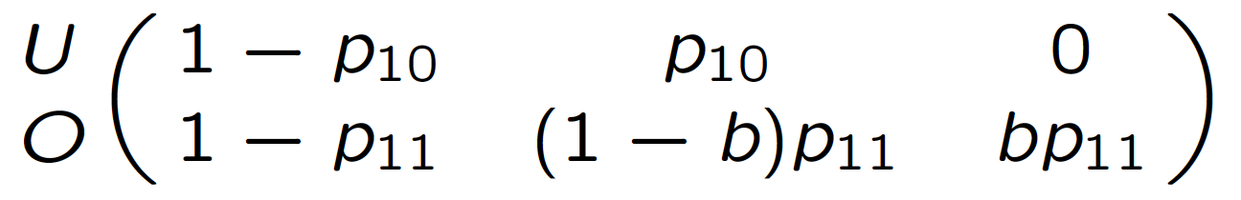
Model allowing for false positives
Observation process
0
1
2
p₁₀ = probability of false positive detection
Notes:
More precisely, the initial states and the observation process are the same as in the dynamic model.
It’s only the state process that is now driven by the identity matrix, meaning that you stay in the state you are initially in.

Slide 78
Model allowing for false positives
Observation process
0
1
2
p₁₁ = probability of detection
b = probability that a detection is classified as unambiguous
Notes:
More precisely, the initial states and the observation process are the same as in the dynamic model.
It’s only the state process that is now driven by the identity matrix, meaning that you stay in the state you are initially in.

Slide 79
Estimates of occupancy for gray wolves in northern Montana from 2007–2010
Notes:
False negatives led to underestimation of occupancy,

Slide 80
Estimates of occupancy for gray wolves in northern Montana from 2007–2010
Notes:
while false positives led to over-estimation of occupancy,

Slide 81
Live demo
Estimating wolf occupancy with R
Notes:
Today I’m gonna talk about SDM obviously, and a particular class of occupancy models that have been specifically designed to
account for the imperfect detection of species.
This is joint work with several colleagues, some of them from the French Game and Wildlife Agency and others from the CEFE, including two
very clever PhD students of mine : Julie and Laetitia.

Slide 82
Lecture 5 Estimating species co-occurrence
Estimating wolf occupancy with R
Notes:
Today I’m gonna talk about SDM obviously, and a particular class of occupancy models that have been specifically designed to
account for the imperfect detection of species.
This is joint work with several colleagues, some of them from the French Game and Wildlife Agency and others from the CEFE, including two
very clever PhD students of mine : Julie and Laetitia.

Slide 83
Rationale
Several (say 2) different species on a site
Interactions affect occupancy probabilities
Detection of a species affected by presence of another one: blurred interactions
Examples: predation, mutualism, competition, …
Notes:
Do some species tend to occur more (or less) often together than expected?
A great deal of literature has been published during past 30 years on methods for assessing patterns of co-occurrence, but not accounting for detectability.

Slide 84
Questions you might want to ask
Are the species interacting or not? (beware: co-occurrence is not necessary interaction)
Do species interactions vary along an environmental gradient?
What is marginal occupancy probability of some species (that is averaged on presence/absence of all other species)
What is probability of some species conditional on presence or absence of other species
What is the relative contribution of environmental vs species interactions in occupancy?

Slide 85
States
U = site unoccupied
A = site occupied by species A only
B = site occupied by species B only
AB = site occupied by both species
Notes:
Do some species tend to occur more (or less) often together than expected?
A great deal of literature has been published during past 30 years on methods for assessing patterns of co-occurrence, but not accounting for detectability.

Slide 86
State process
ψ^{Α} = prob. a site is occupied by species A
ψ^{Β} = prob. a site is occupied by species B
ψ^{ΑΒ} = prob. a site is occupied by species A and B
Notes:
Do some species tend to occur more (or less) often together than expected?
A great deal of literature has been published during past 30 years on methods for assessing patterns of co-occurrence, but not accounting for detectability.

Slide 87
Conditional probabilities
ψ^{Α|Β} = prob. a site is occupied by species A given presence of species B = ψ^{ΑΒ} / ψ^{Β}
ψ^{Β|Α} = prob. a site is occupied by species B given presence of species A = ψ^{ΑΒ} / ψ^{Α}
Notes:
Do some species tend to occur more (or less) often together than expected?
A great deal of literature has been published during past 30 years on methods for assessing patterns of co-occurrence, but not accounting for detectability.

Slide 88
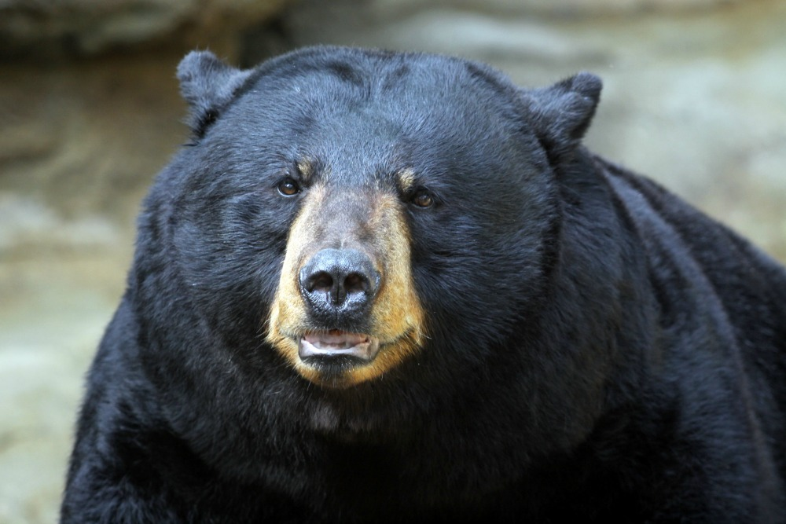
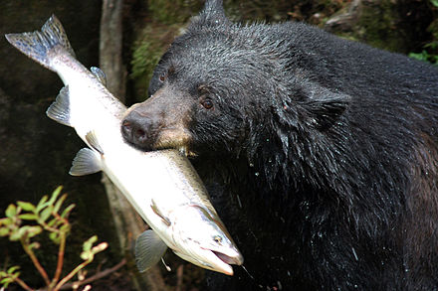
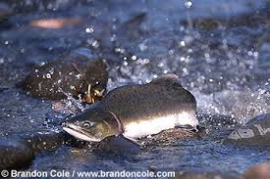
Venn diagram
Occupied by species A only
Occupied by both species
Occupied by species B only
ψ^{Α} – ψ^{ΑΒ}
ψ^{ΑΒ}
ψ^{Β} – ψ^{ΑΒ}
Site unoccupied with prob.: 1 – ψ^{Α} – ψ^{Β} + ψ^{ΑΒ}
Notes:
Do some species tend to occur more (or less) often together than expected?
A great deal of literature has been published during past 30 years on methods for assessing patterns of co-occurrence, but not accounting for detectability.

Slide 89
Events
0 = species undetected
1 = A detected
2 = B detected
3 = both species detected
Notes:
Do some species tend to occur more (or less) often together than expected?
A great deal of literature has been published during past 30 years on methods for assessing patterns of co-occurrence, but not accounting for detectability.

Slide 90
Observation process
p^{A} = prob. detecting species A given only species A is present
p^{B} = prob. detecting species B given only species B is present
r^{AB} = prob. detecting both species A and B when both present
r^{Ab} = prob. detecting species A but not B when both present
r^{aB} = prob. detecting species B but not A when both present
r^{ab} = prob. detecting neither species when both present
Notes:
Do some species tend to occur more (or less) often together than expected?
A great deal of literature has been published during past 30 years on methods for assessing patterns of co-occurrence, but not accounting for detectability.

Slide 91
Initial states
Initial states
U A B AB
Notes:
More precisely, the initial states and the observation process are the same as in the dynamic model.
It’s only the state process that is now driven by the identity matrix, meaning that you stay in the state you are initially in.

Slide 92
State process
State process
U A B AB
U
A
B
AB
Notes:
More precisely, the initial states and the observation process are the same as in the dynamic model.
It’s only the state process that is now driven by the identity matrix, meaning that you stay in the state you are initially in.

Slide 93
Observation process
Observation process
0 1 2 3
U
A
B
AB
Notes:
More precisely, the initial states and the observation process are the same as in the dynamic model.
It’s only the state process that is now driven by the identity matrix, meaning that you stay in the state you are initially in.

Slide 94
Quantifying interactions
Interaction estimated by: η = ψ^{AB} / (ψ^{A} ψ^{B})
< 1 – avoidance (less frequent than expected)
> 1 – convergence (more frequent than expected)
= 1 – independence (ψ^{AB} = ψ^{A} ψ^{B})
Notes:
More precisely, the initial states and the observation process are the same as in the dynamic model.
It’s only the state process that is now driven by the identity matrix, meaning that you stay in the state you are initially in.

Slide 95
Live demo
Estimating wolf occupancy with R
Notes:
Today I’m gonna talk about SDM obviously, and a particular class of occupancy models that have been specifically designed to
account for the imperfect detection of species.
This is joint work with several colleagues, some of them from the French Game and Wildlife Agency and others from the CEFE, including two
very clever PhD students of mine : Julie and Laetitia.

Slide 96
Lecture 6 Conclusions
Estimating wolf occupancy with R
Notes:
Today I’m gonna talk about SDM obviously, and a particular class of occupancy models that have been specifically designed to
account for the imperfect detection of species.
This is joint work with several colleagues, some of them from the French Game and Wildlife Agency and others from the CEFE, including two
very clever PhD students of mine : Julie and Laetitia.

Slide 97
Conclusions
1. We covered several occupancy models
Single-season, dynamic models
False-positives
Species interactions
Notes:
What are the advantages of the HMM formulation of occupancy models?
The first big advantage is that we now have a unified framework in which we can basically fit all occupancy models:
The other big advantage is that, with HMM, we have a formal link between the capture-recapture and occupancy worlds,
and this link might reveal very useful for occupancy models, and vice versa obviously!

Slide 98
Conclusions
1. We covered several occupancy models
Single-season, dynamic models
False-positives
Species interactions
2. Implementation in R using package unmarked
Notes:
What are the advantages of the HMM formulation of occupancy models?
The first big advantage is that we now have a unified framework in which we can basically fit all occupancy models:
The other big advantage is that, with HMM, we have a formal link between the capture-recapture and occupancy worlds,
and this link might reveal very useful for occupancy models, and vice versa obviously!

Slide 99

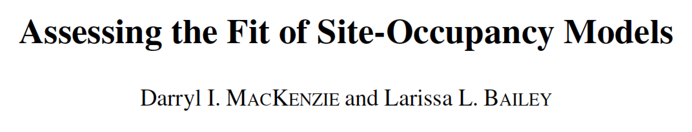
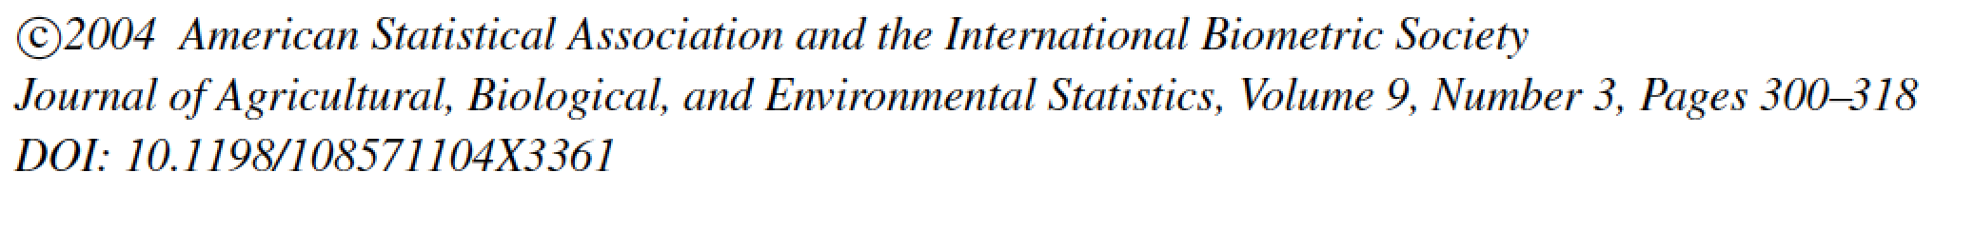
We did not cover…
How to choose sites? Occasions?
site selection
allocation of effort
design comparisons
survey timing
Goodness-of-fit testing
A few other models…
habitat and species occurrence dynamics, multistate, heterogeneity, …
Notes:
What are the advantages of the HMM formulation of occupancy models?
The first big advantage is that we now have a unified framework in which we can basically fit all occupancy models:
The other big advantage is that, with HMM, we have a formal link between the capture-recapture and occupancy worlds,
and this link might reveal very useful for occupancy models, and vice versa obviously!

Slide 100
References – methods & applications
Guillera-Arroita, G. (2017), Modelling of species distributions, range dynamics and communities under imperfect detection: advances, challenges and opportunities. Ecography, 40: 281-295.
Louvrier, J., C. Duchamp, V. Lauret, E. Marboutin, S. Cubaynes, R. Choquet, C. Miquel, O. Gimenez (2017). Mapping and explaining wolf recolonization in France using dynamic occupancy models and opportunistic data. Ecography. 41: 647-660.
MacKenzie, D. I., Nichols, J. D., Royle, J. A., Pollock, K. H., Bailey, L., & Hines, J. E. (2018). Occupancy estimation and modeling: Inferring patterns and dynamics of species occurrence, 2nd edition. San Diego, CA: Academic Press.
Miller, D. A. W., Nichols, J. D., Gude, J. A., Rich, L. N., Podruzny, K. M., Hines, J. E., & Mitchell, M. S. (2013). Determining occurrence dynamics when false positives occur: Estimating the range dynamics of wolves from public survey data. PLoS ONE, 8, e65808.
Rota, C. T., Fletcher Jr, R. J., Dorazio, R. M., & Betts, M. G. (2009). Occupancy estimation and the closure assumption. Journal of Applied Ecology, 46, 1173– 1181.

Slide 101
References – software
Doser, J. W., Finley, A. O., Kéry, M., & Zipkin, E. F. (2022). spOccupancy: An R package for single-species, multi-species, and integrated spatial occupancy models. Methods in Ecology and Evolution, 13, 1670– 1678.
Fiske, I., & Chandler, R. (2011). unmarked: An R Package for Fitting Hierarchical Models of Wildlife Occurrence and Abundance. Journal of Statistical Software, 43(10), 1–23.
Kellner, K.F., A.D. Smith, J.A. Royle, M. Kéry, J.L. Belant, R. B. Chandler (2023). The unmarked R package: Twelve years of advances in occurrence and abundance modelling in ecology. Methods in Ecology and Evolution. In Press.
Gimenez, O., Blanc, L., Besnard, A., Pradel, R., Doherty, P.F., Jr, Marboutin, E. and Choquet, R. (2014), Fitting occupancy models with E-SURGE: hidden Markov modelling of presence–absence data. Methods in Ecology and Evolution, 5: 592-597.
Kellner, K. F., Fowler, N. L., Petroelje, T. R., Kautz, T. M., Beyer, D. E., & Belant, J. L. (2022). ubms: An R package for fitting hierarchical occupancy and N-mixture abundance models in a Bayesian framework. Methods in Ecology and Evolution, 13, 577– 584.

